Slide 1


Oracle PartnerNetwork Opportunities
Jay Messenger
Team Lead, US SLG and Canada Hardware
Oracle Public Sector Channels Organization
Notes:
“I know what most of you are thinking. Oracle’s too big for me. Oracle’s too big or expensive for my customers. I’m going to zone out now and do email on my iphone for the next 20 minutes. Let me tell you why that would be a mistake. Here’s the Oracle of the past – big relationships with Accenture and all of their buddies. Maybe we were a little arrogant and even ignored you. Here’s the Oracle of today. We’ve got a partnership opportunity and product for everyone. We can reach down to customers as small as 250 seats. We’ve got one of the strongest brands in IT. We can help you grow your business.”

Slide 2

Oracle Corporation
SCALE
INNOVATION
$36.9B in revenue on a trailing twelve-month basis*
2nd largest Enterprise Software co.
#1 in 50 product/industry categories
390,000 customers in 145 countries
25,000 partners
115,000 employees
Founder-led Company
34,000 developers and engineers
18,000 customer support specialists, speaking 29 languages
18,000 implementation consultants
15 million developers in Oracle online communities
2 million students supported annually
900 independent Oracle user groups with 500,000 members
* GAAP revenue reported in USD as of August 31, 2012
Notes:
Some quick facts about Oracle…

Slide 3
Investment in Innovation and Integration
MORE THAN $29B IN R&D SINCE 2004
Figures in GAAP
Notes:
Since 2004, Oracle had invested more than US$29 billion in continued innovation of our products, so we can ensure that each of our product is best-of-breed in the industry and in integration, so we can deliver products that work together.
Sought acquisitions to round out footprints in our industries, healthcare, communications, retail, utilities, etc.
Ultimate benefit to customers with end to end integration
Done this so our partners can create value added services and wrap that around our products to offer compelling customer solutions.
- analytics to improve sales productivity
-- private cloud to offer capacity on demand

Slide 4









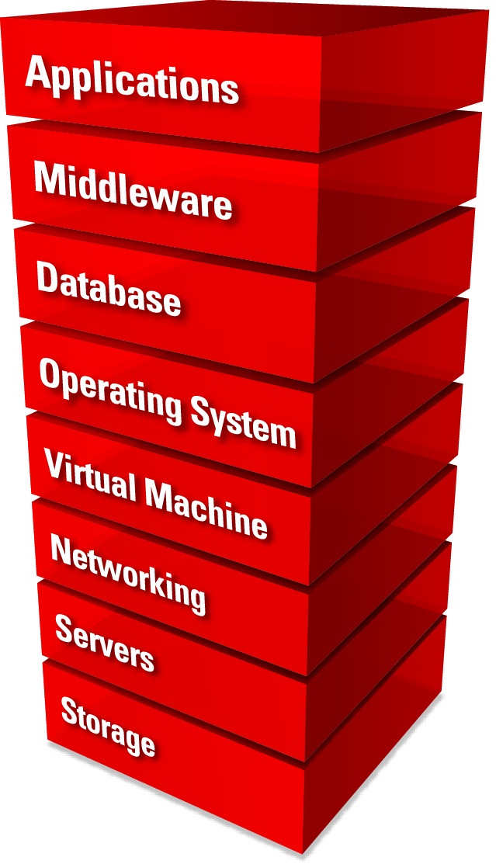






































































Oracle Acquisitions
APPLICATIONS
(pending)
MIDDLEWARE
Middleware Platform
and Management
Business Intelligence
Identity and Access Management
Performance Management
Enterprise Content Management
Data Integration
DATABASE
OPERATING SYSTEM AND VIRTUAL MACHINE
Operating System
Systems Management
Virtual Machine
SERVERS AND STORAGE
Notes:
Part of that spend goes into integrating the many companies that Oracle has acquired over recent years. Each acquisition has helped to grow the portfolio that we can offer to customers. This provides tremendous opportunity to our partners to also grow their footprint within their customer base.

Slide 5

Oracle Strategy
Complete Stack
Complete Customer Choice
Best-of-Breed
Open
Vertical Integration
Extreme Performance
Engineered Systems
On-Premise
Private Cloud
Public Cloud
Hybrid
Notes:
Everything from Apps to Disk
One red stack vs. Piecemeal solution from multiple vendors
Engineered to work together
Huge competitive advantage
Terrific value-add story for end users and partners
Oracle on Oracle solves the CIO constraints we just discussed
Faster uptimes
Better, faster access to data
Only Oracle can offer this level of value
Transition: To highlight a few specific high-value areas…

Slide 6
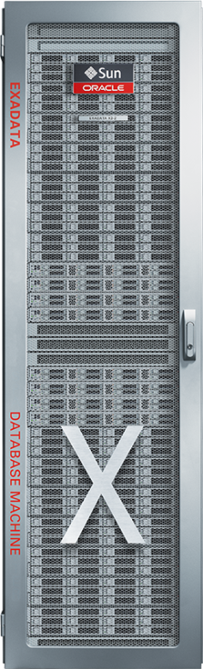
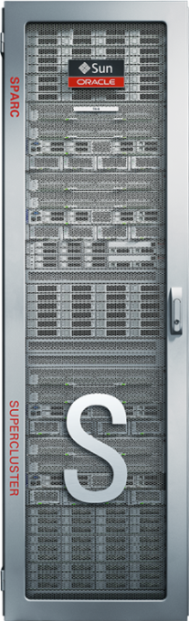
Our Market Potential is Massive
Total Market Opportunity for Hardware Running Oracle Apps & Oracle Database: $26.8B
Storage: $9.5B Servers: $17.3B
Market Share Impact if 25% HW Conversion of Total SW Opportunity:
Storage: 19% Share Servers: 20% Share

Slide 7




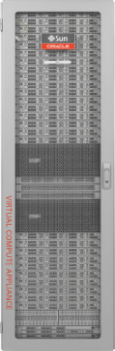
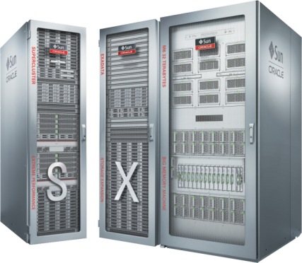
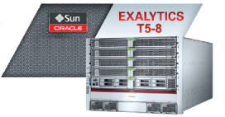
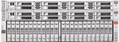





Oracle Engineered Systems
Big Data Appliance
Exalogic
Elastic Cloud
Backup, Logging and Recovery Appliance
Virtual Compute Appliance
Exalytics
Database Appliance
SuperCluster
Exadata

Slide 8
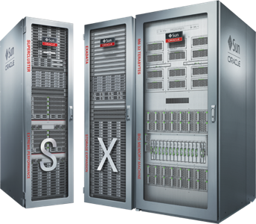
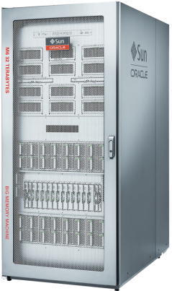



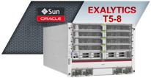
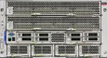


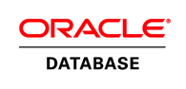




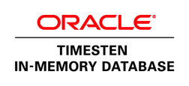

Best Enterprise Portfolio
Engineered Systems
Entry-Level
Mid-Range
High-End
T4-1B
T5-1B
T4-1
T4-2
T5-2
T5-8
SuperCluster T5-8 and M6-32
Exalytics T5-8
T5-4
M6-32, M5-32
T4-4

Slide 9

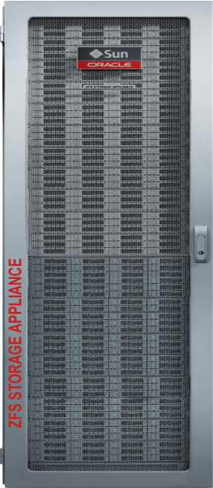


An Application-Engineered Portfolio for Data Storage & Archive
ZFS
Axiom
StorageTek
APPLICATION ENGINEERED STORAGE
NAS for High-Performance Databases
SAN for Application Consolidation
Tape for Deep Archive
Notes:
This is Oracle’s line up of Application Engineered Storage, all with unique characteristics only available on Oracle storage.
The Sun ZFS Storage Appliance, a high performance NAS system
The Pillar Axiom for SAN-based application consolidation, and
The StorageTek family of tape library systems, drives, media for long-term data archive.

Slide 10
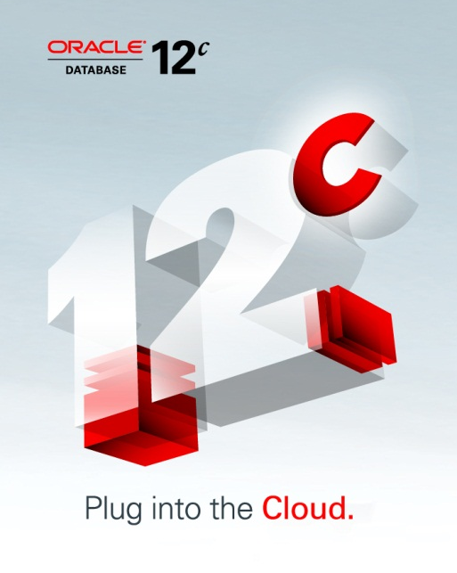
Oracle Storage Saves You Time and Money
65% reduction in administration and provisioning
Dynamically tuned to optimize database performance
44% faster troubleshooting
DTrace storage analytics provides deeper understanding, more quickly
5 of 10 storage administrators can be repurposed
Deliver strategic projects faster
$1M potential savings annually
Notes:
In fact, Oracle can save you money not just with the reduction in the number of systems you purchase and their costs – but also in your operational expenses.
Oracle Storage is engineered exclusively with Oracle Database 12c to communicate critical tuning parameters to the storage, so it can automatically configure itself and reduce administration and provisioning time by more than 65%
With Dtrace storage analytics, external analysts have shown that we can reduce the time it takes to troubleshoot an environment by 44% when compared to NetApp.
And, when taken together this means that you can repurpose ½ of the storage admins that you currently have supporting your mountain of NetApp filers to work on more strategic projects. This means that you can deliver strategic projects faster, have a larger positive impact on the business, and save over $1M per year in the administration of your storage environment.

Slide 11
Oracle Database Runs Best on Oracle Storage Only on Oracle: Hybrid Columnar Compression (HCC)
Real World Results
Trials on queries and large customer tables in retail, financial and telco
Up to 50x compression
3x to 8x faster queries
Increased performance for most data warehouse and data protection workloads
Compression Ratio
Increased Query Speed
11g query time
Query
Available with Oracle Database 12c, and Only with Oracle Storage
Notes:
What we have seen in real-world environments is that typical queries compress about 12 or 13x, and that it accelerates many queries by reducing the data access latency and increasing the amount of current data that is held in database, server, or storage cache. It is particularly important in data warehouses and where enterprises need to maintain long term archives of database data.
Of course, whether you are using Oracle Database 11g or 12c, Hybrid Columnar Compression is only available on Oracle Storage – Oracle Exadata Storage Servers, ZFS Storage Appliance, and Pillar Axiom.

Slide 12

Oracle PartnerNetwork Delivering Value
Notes:
So, let’s talk about Oracle PartnerNetwork (or OPN) and how our partner engage to benefit from the market opportunity that Oracle provides.

Slide 13


WHY Partner with Oracle
MASSIVE
CUSTOMER INSTALL BASE
400,000+ Oracle customers
UNPARALELLED
PRODUCT PORTFOLIO
Innovation through Engineered Systems
COMPELLING
CHANNEL PROGRAM
Competitive margins and programs
Notes:
We’re growing in a challenging market
Where do you see your growth coming from in the next few years?
Look at your install base for Oracle
Best product portfolio
Solid partner program with minimal competition
Transition: Even better to hear it form someone else…

Slide 14
Partner Revenue Mix – Today vs. Expected 2015
Source: UBM Channel
Notes:
Over the past 10 years, Oracle has acquired over 90 companies.
But there’s one company we haven’t acquired.
Services.
This is where we count on our OPN Members. We need partners to round out solutions to deliver them to our customers. Striped by industry, bring innovation to the marketplace.
And do so to profit handsomely. Today, the largest and most profitable part of your revenue mix is services. Over 47%.
HP bought EDS. IBM has Global Services.

Slide 15



Oracle PartnerNetwork Ecosystem
25,000+ PARTNERS WORLDWIDE
5,000+ SPECIALIZED PARTNERS
150+ AVAILABLE SPECIALIZATIONS
100,000+ CERTIFIED PROFESSIONALS
COMMON MODEL FOR SOFTWARE & HARDWARE
6,000+ PRODUCTS FOR PARTNER RESELL

Slide 16

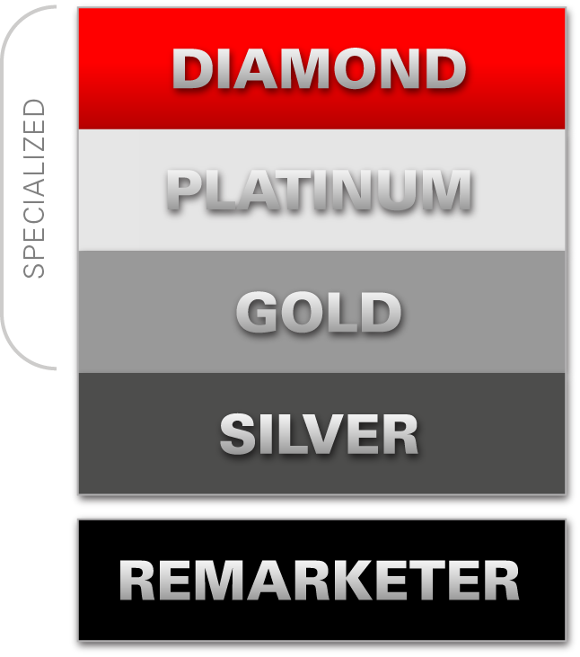
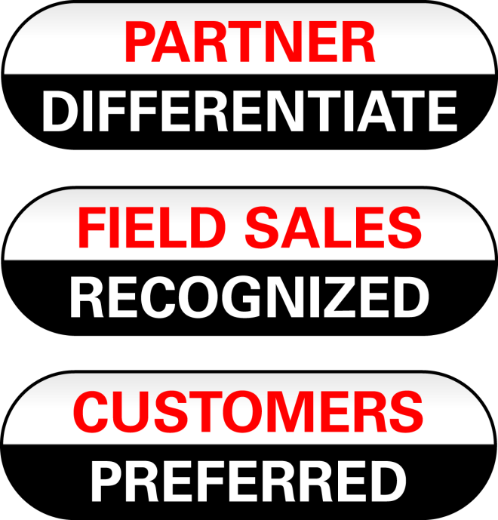
Notes:
16
The OPN program is flexible and designed to evolve with our partners’ business needs. OPN Members at the Gold level and above can access increased benefits and visibility through Specialization.
As we consider the Oracle PartnerNetwork program and how we work with our members, we assure we are delivering value to three primary groups: our community of partners, our end customers and our Oracle internal sales force.
The OPN Specialized program provides partners with tools to better develop, sell, and implement Oracle solutions.
Specialization is the key for our Members to differentiate in the marketplace, be recognized by Oracle and preferred by customers.
Oracle Partner Network, is our flagship partner Program.
The program offers tools to better develop, sell, and implement Oracle broad solutions.
At silver, partners get resources and support directly from Oracle. At gold, partners sell our entire product portfolio and begin to Specialize. Partners get specialized by meeting specific business and competency criteria. Specializations are available in over 150 of Oracle’s key product areas. With 5 specializations, partner can become platinum, and our Diamond level is for those partners who have over 30 specializations.
Specialized partners are differentiated; Oracle recognizes these partners and specialization offers a system of preference for our customers.
These partners are directly promoted to oracle’s customers through our showcase site oracle.com/specialized.
We make videos, we create case studies, we blog about you. No other vendor does this.
Ultimately, this recognition helps partners drive demand and it impacts their sales efforts.

Slide 17

OPN Program Benefits
ENABLEMENT
Competency Center
Free Online Training 24/7
OU Vouchers & Discounts
BootCamps
MARKETING
SUPPORT
Branding & Logos
Marketing Materials
Solutions Catalog
Award Wining Tech Support
Partner Business Center
Oracle Technology Network
SALES
DEVELOPMENT
Opportunity Registration
Referral & Registration Benefits
OPN Incentive Program
Free Licenses
Integration Opportunities
ISV Communities
Notes:
OPN offers a vast array of benefits for partners. These span Sales, Marketing, Enablement, Support and Development.
Sales – Oracle has distribution agreements that fit our partners’ various business models. A key Sales benefit is the Oracle Open Market Model (or OMM). Partners can resell products or refer opportunities to Oracle and receive benefits from registering those opportunities in OMM. Oracle also provides partners with sales tools and kits.
Marketing – We also offer many Marketing benefits. Partners can develop customer success stories with Oracle, as well as submit articles to and advertise in Oracle Profit and Oracle Magazine. Exhibit and speaking opportunities at Oracle events, including Oracle OpenWorld, are also available to OPN members. Various Oracle branding options are available for a partner’s level in the program, for any specializations they achieve, as well as for achievement of other specific partner designations and awards. We provide marketing kits with templates, tools and guidance on marketing campaigns for partners to use as well.
Development – Partners receive a license to download Oracle products for development and demonstration purposes. We also have a number of offerings for technology partners who develop solutions to run on or integrate with Oracle technology and applications.
Support – OPN members receive complimentary access to My Oracle Support to search for solutions, download patches and updates, access proactive support tools and collaborate in communities. Specialized partners receive the right to log a number of Service Requests based on the number of specializations they achieve. Partners who are not specialized can purchase SR packs at a discounted price.
Enablement – And, finally, Oracle has a vast array of education and enablement benefits available to all OPN members. We provide free online training via thousands of online courses available through the Oracle University Knowledge Center and the OPN Competency Center. To make it easier for partners to select appropriate courses, we’ve developed the Guided Learning Paths that are available through the OPN Competency Center. In addition, partners receive a discount on other Oracle University training as well as vouchers to take certification exams. Partners may also attend Boot Camps designed exclusively for partners, providing "jump start", in-depth, role-based training.
The detailed listing of benefits is available on the OPN Website at www.oracle.com/partners.

Slide 18
Notes:
ORACLE AND PUBLIC SECTOR
Expanding your business into the Public Sector market opens the doors to a $79B US Federal IT market and a $92B US State and Local Government Market.
The Federal government is required to conduct 30% of its business through minority, women-owned, 8A and small businesses. Become one of the select few Oracle resellers who can sell into this enormous market!
TREMENDOUS MARKET OPPORTUNITY
S&LG budgets are growing while others shrink
Industry solutions – like Health and Human Services – are here to stay in government (HHS is 30% of state budgets; predicted IT spend is $30B in 2012 for state HHS solutions)
Massive need for upgrades
Cloud, Consolidation, Mobility are key solutions MANDATES
2. MASSIVE INSTALL BASE
Hundreds of states, cities and municipalities run Oracle products - cross & up-sell
EASY TO EXPAND INTO PUBLIC SECTOR
Simple addendum to existing FUDA
Team with other SIs if you are a small partner
Specific events and communities for Oracle Public Sector partners
50 of the 50 US States, and 20 of the top 20 counties are Oracle customers - we seek resellers to grow and maintain that business through lucrative government contracts.
The complete line of Oracle products – the full red stack – offers an end-to-end solution sale no other manufacturer can, and which government datacenters crave. Once established, government contract business can offer years of reliable, repeat business and loyal customers.
The top ten states will spend over $21B on IT in 2013
The top 10 cities will spend over $1.5B on IT in 2013
Data Center consolidation and Cloud Computing are mandates government customers are facing – Oracle has the turnkey solution they seek
Cost reduction through improvement in efficiency, power savings and processing speed make Oracle the obvious choice for governments

Slide 19
VP North America Public Sector Channels
Manager Federal SI’s
Manager SLG/Canada
Manager Federal
GRPG
Engineered Systems
Channel Managers
Team Leads Responsible for all CM’s in Geo’s
Hardware (HW) Channel Managers
Software (SW) Channel Managers
Government Resell Programs Group
Supports the Entire Public Sector Channel Organization
Responsible for managing all Oracle held and partner held non-standard contract vehicle requests
All partner requests for adding Oracle products to programs and or contracts
Manages partner compliance with PSA, FUDA and OPN agreement
All Public Sector due diligent issues
Partner business practices and Public Sector business strategy
Compliance training and facilities visits

Slide 20
(PS)Public Sector Channels Organization North America Coverage and Deal Support for Partners
End User Customers | Tech Software | Apps Software | Engineered Systems | HW (Servers, Storage, Tape)
Canada (All Public Sector) | PS-SW Channel Manager | PS-SW Channel | PS-Eng Sys Channel Manager | PS-HW Channel Manager
US SLG | PS-SW Channel Manager | PS-SW Channel Manager | PS-Eng Sys Channel Manager | PS-HW Channel Manager
Higher Ed | PS-SW Channel Manager | * Commercial-SW Channel Manager | PS-Eng Sys Channel Manager | * Commercial-HW Channel Manager
Federal | PS-SW Channel Manager | PS-SW Channel Manager | PS-Eng Sys Channel Manager | PS-HW Channel Manager
Healthcare | PS-SW Channel Manager | * Commercial-SW Channel Manager | PS-Eng Sys Channel Manager | * Commercial-HW Channel Manager
* Apps SW and HW products coverage has not moved into Oracle Public Sector as of June 1, 2014

Slide 21
FY15 US SLG HW Channel Managers Coverage Map
East/Central Carolyn Assad
Boston, MA
ME
WA
MT
ND
MN
V T
N
H
OR
WI
NY
MA
ID
SD
MI
CT
RI
WY
PA
NJ
DE
IA
NE
IN
OH
MD
NV
IL
DC
WV
UT
CO
MO
VA
KS
KY
CA
NC
TN
OK
AR
SC
AZ
NM
Jay Messenger
Team Lead
Reston, VA
AL
GA
MS
TX
LA
West/Central
Michael Murphy
San Diego, CA
US SLG
Mandy Jandik
Denver, CO
FL
Andrew Thomas
Tier III Approver
Dallas, TX
AK
HI

Slide 22

FY15 Canada HW Channels Coverage Map
Canada
Joy Everett

Slide 23
FY15 S&L SW Channels Coverage Map
Northeast
Sarah Bobby
ME
WA
MT
ND
MN
VT
N
H
OR
WI
NY
MA
ID
SD
MI
CT
RI
WY
PA
NJ
DE
IA
NE
IN
OH
MD
NV
IL
DC
WV
UT
CO
MO
VA
KS
KY
CA
NC
TN
OK
AR
SC
AZ
NM
Mid-Atlantic
Jodi Thomas
West
Jim Sanchez
AL
GA
MS
TX
LA
Rockies &
Central
Julie Guerrero
FL
HI
South
Heather Sklar
AK
Engineered Systems – Erin Ireland
Engineered Systems – Norma Dubois

Slide 24
声明：
所有的版权属于原有公司，文件均来自公开渠道
此文件仅供学习使用，任何人不得进行以此为商业目的的行为
如有疑问，请立即删除
学习世界五百强和咨询公司PPT课程请访问如下网站搜索：“司马懿”
百度传课：司马懿PPT学校
https://www.chuanke.com
网易学堂：司马懿PPT学校
https://study.163.com
知乎： 司马懿PPT学校
https://www.zhiu.com

